Slide 1
第1章 概率论基础
生物信息中的统计模型 (2016年春)
G. Casella “Statistical Inference”
Chapter 1-3
感谢清华大学自动化系江瑞教授提供PPT

Slide 2
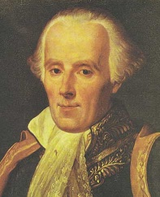
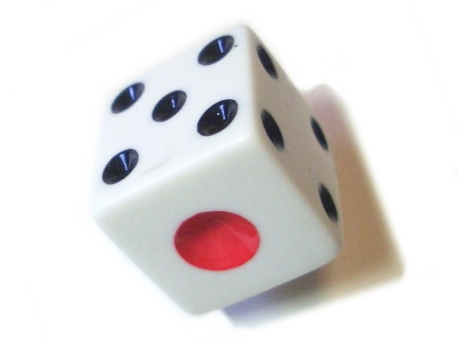
Classical Probabilities
Pierre-Simon Laplace
Théorie analytique des probabilités
The probability of an event is the ratio of the number of cases favorable to it, to the number of all cases possible when nothing leads us to expect that any one of these cases should occur more than any other, which renders them, for us, equally possible.
http://en.wikipedia.org/wiki/Classical_definition_of_probability

Slide 3
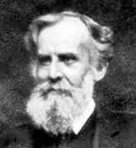
Frequency Probabilities
John Venn
Frequency probabilities
Probabilities are related to well-defined random experiments. The set of all possible outcomes of a random experiment is called the sample space of the experiment. An event is defined as a particular subset of the sample space. The relative frequency of occurrence of an event, in a number of repetitions of the experiment, is a measure of the probability of that event.
http://en.wikipedia.org/wiki/Frequency_probability

Slide 4
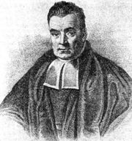
Subjective Probabilities
Thomas Bayes
Bayesian probability
Probability is the degree to which a person (or community) believes that a proposition is true, the degree of belief.
http://en.wikipedia.org/wiki/Bayesian_probability

Slide 5
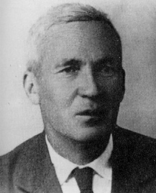
Axiomatic Definition
Probability axioms
Kolmogorov
http://en.wikipedia.org/wiki/Kolmogorov_axioms

Slide 6
Random Experiments（随机试验）
Random experiments
随机试验在相同的条件下可以重复进行
随机试验的所有可能结果能够事先明确地指出来
某一次随机试验的结果不能在试验进行之前预料到

Slide 7
Sample Space（样本空间）
Sample space
有限可列 (Finite countable)
无限可列 (Infinite countable)
无限不可列 (Infinite uncountable)

Slide 8
Examples of random experiments
随机试验
掷一只骰子，观察朝上一面的点数
在一批产品中，任取一件，观察是正品还是次品
射击一目标，直到击中为止，记录射击的次数
从一批灯泡中，任取一只，测其寿命
样本空间
掷骰子试验（有限可列）： S = {1,2,3,4,5,6}
取一件产品（有限可列）： S = {正品，次品}
射击目标试验（无限可列）： S = {1,2,3,…}
灯泡寿命试验（无限不可列）： S = {t|t0}

Slide 9
Random Event （随机事件）
基本事件 vs. 复合事件
必然事件 vs. 不可能事件
Event

Slide 10
Event Operations
包含 Containment
合集 Union
交集 Intersection
补集 Complementation
差集 Theoretic difference

Slide 11
Extension of Event Operations
Countable infinite collection of sets
Uncountable infinite collection of sets

Slide 12
Sigma Algebra
sigma algebra (Borel field)

Slide 13
Examples of Sigma Algebra-I
B₁ = { , S} (the trivial sigma algebra)
 B₁
B₁ is closed under complementation
B₁ is closed under countable unions

Slide 14
Examples of sigma algebra-II
B₂ = {all subsets of S, including S itself}
 B₂
B₂ is closed under complementation
B₂ is closed under countable unions
Example
B = { , {1}, {2}, {3}, {1,2}, {1,3}, {2,3}, {1,2,3}} for S = {1,2,3}

Slide 15
Properties of a sigma algebra
is always in a sigma algebra
By definition (1)
S is always in a sigma algebra
By definitions (1) and (2)
A sigma algebra is also closed under countable intersections
By definition (2), (3), and the DeMorgan’s law

Slide 16
Kolmogorov Axioms
Kolmogorov axioms
可列可加性

Slide 17
Defining Probability Functions

Slide 18
Satisfaction of the Kolmogorov Axioms

Slide 19
Classical Probabilities
Sample space S = {s₁,s₂, …,s_{n}} A finite countable sample space
Define probability P(s_{i}) = p_{i} = 1/n Equal probability
Probability function where A  B = {all subsets of S, including S itself}

Slide 20

Dice
Sample space S = {1, 2, 3, 4, 5, 6}
Define probability P(s_{i}) = 1/6
Probability function
Calculation
P(观测到 3 的概率) = 1/6
P(观测到奇数点的概率) = 3/6 = 1/2
P(观测到大于等于 3 的概率) = 4/6 = 2/3

Slide 21
The Calculus of Probabilities
For two events

Slide 22
The calculus of probabilities
For countable events

Slide 23
Conditional Probability
样本空间由 S 变为 B
Conditional probability

Slide 24
Satisfaction of the Axioms

Slide 25
Statistically Independent
Statistically independent

Slide 26
Multiplication Rule
Multiplication rule

Slide 27
Multiplication Rule
Multiplication rule

Slide 28
Chain Rule
Chain rule

Slide 29
Law of Total Probability
Law of total probability

Slide 30
Bayes’ Rule
Bayes’ rule

Slide 31
随机变量

Slide 32
Tossing coins
扔一枚硬币，观察到正面的概率
S = {H, T}
P(正面) = P({H}) = 1/2
扔一枚硬币三次，观察到两次正面的概率
S = {HHH, HHT, HTH, THH, TTH, THT, HTT, TTT}
P(两次正面) = P({HHT, HTH, THH}) = 3/8
扔一枚硬币一百次，观察到十次正面的概率
S = {2¹⁰⁰ elements}
P(十次正面) = Unable to count!
实际上正面出现的次数仅有101种可能
It is much easier to deal with a summary variable than with the original probability structure.

Slide 33
How to Reduce the Sample Space?
定义计数函数
X(s) = #{H}
定义域 S 包含 2¹⁰⁰ 个元素
值域 [0, 100] 包含 101 个元素
观察到十次正面的次数
P(#{H}=10)=P(X=10)=C(100,10)0.5¹⁰0.5⁹⁰1.3710⁻¹⁷
扔任意硬币 n 次，观察到 x 次正面的次数
P(X=x | n, p) = C(n, k)  p^{k}  (1p)^{nk}

Slide 34
Random Variables
Random variable
随机变量是定义在样本空间上的实值函数
随机变量用大写字母表示，例如X, Y, Z
随机变量的取值用对应的小写字母表示，例如x, y, z

Slide 35
Change of the Sample Space
样本空间的转换
在随机变量的定义域上 S = {s₁, s₂, …, s_{n}}
在随机变量的值域上 X = {x₁, x₂, …, x_{m}}
随机变量建立的映射 X: S  X
定义在随机变量定义域上的概率函数
P(s_{j}) = p_{j}
P(A) = _{sjA} p_{j}
定义在随机变量值域上的概率函数
P_{X}(X = x_{i}) = P({s_{j}  S: X(s_{j}) = x_{i}})

Slide 36
Induce a Probability on the Range

Slide 37
随机变量
随机变量的引入简化了研究的问题， 体现了统计学中数据简约的思想
随机变量的取值很重要， 但随机变量以什么概率取得这些值更重要

Slide 38
Distributions of Random Variables
随机变量的所有可能取值及取得每一个值的概率
扔一枚硬币三次，观察出现正面的次数
S = {HHH, HHT, HTH, THH, TTH, THT, HTT, TTT}
X = {0, 1, 2, 3}
X: S  X X(HHH)=3 X(HHT)=2 X(HTH)=2 X(THH)=2 X(TTH)=1 X(THT)=1 X(HTT)=1 X(TTT)=0
P(X = 0) = 1/8 P(X = 1) = 3/8 P(X = 2) = 3/8 P(X = 3) = 1/8

Slide 39
Cumulative distribution function (cdf)
Distribution function

Slide 40
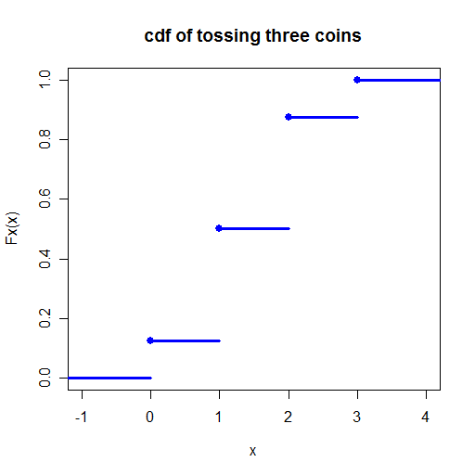
累积分布函数
扔一枚硬币三次，观察出现正面的次数
X = {0, 1, 2, 3}
P(X = 0) = 1/8 P(X = 1) = 3/8 P(X = 2) = 3/8 P(X = 3) = 1/8
分布函数

Slide 41
Necessary and sufficient condition
Necessary and sufficient condition

Slide 42
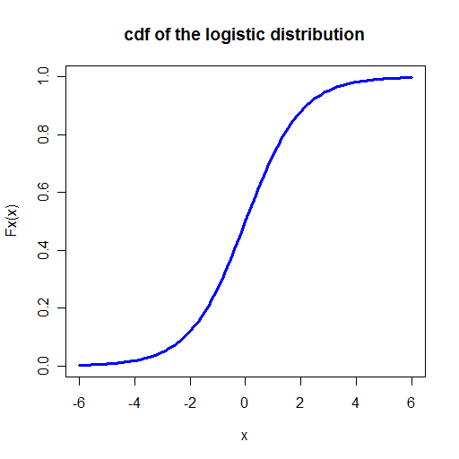
Logistic cdf
Logistic distribution
充要条件的满足性
负无穷时为0
正无穷时为1
不减
右连续

Slide 43
Discrete random variables
Discrete random variables

Slide 44
Continuous random variables
Continuous random variables

Slide 45
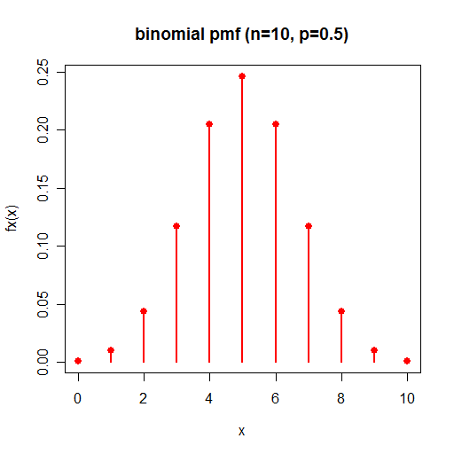
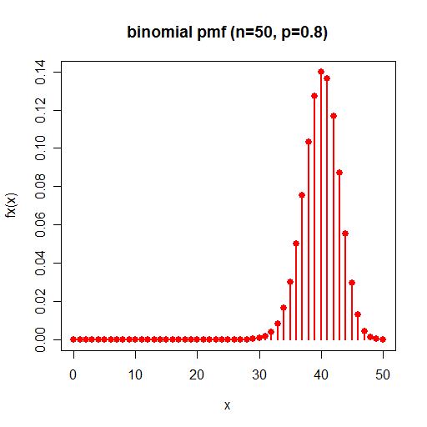
Probability mass functions
Probability mass function
Exact

Slide 46
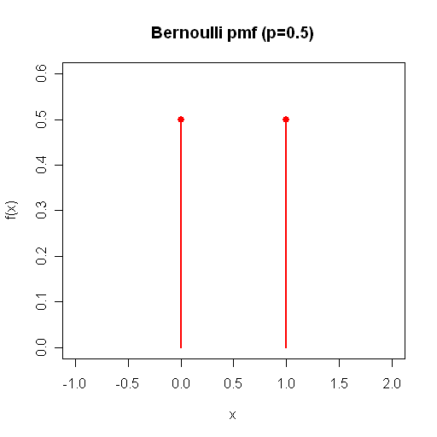
Bernoulli distribution

Slide 47
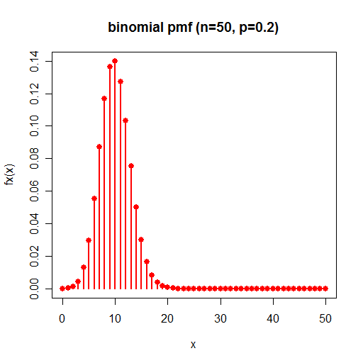
Binomial distribution

Slide 48
For a Continuous Random Variable
P(X=x) = ?
{X = x}  {x-e < X  x} for any x and e
P{X = x}  P{x-e < X  x} = P{X  x  X > x-e} = P{X  x  (X  x-e)^{c}} = P{X  x} - P(X  x  X  x-e} = F_{X}(x) - F_{X}(x-e)
0  P{X = x}  lim_{e0} [F_{X}(x) - F_{X}(x-e)] = 0
P{X=x} = 0 for any x
P{a<X<b}=P{a<X b}=P{aX<b}=P{aXb} for any x

Slide 49
Probability Density Functions
Probability density function

Slide 50
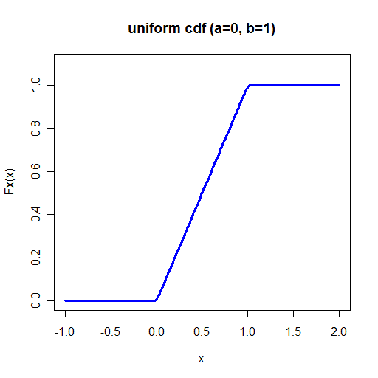
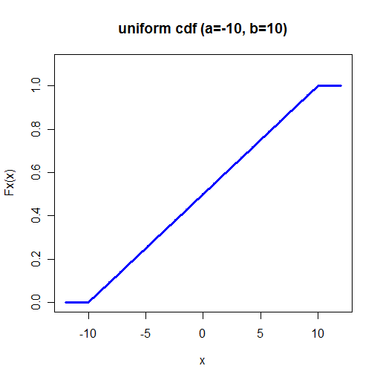
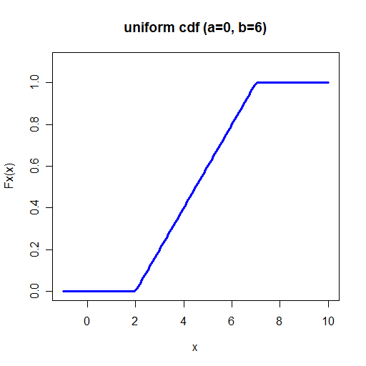
Uniform distribution

Slide 51
Relation of cdfs and pdfs

Slide 52
Necessary and sufficient condition
Necessary and sufficient condition

Slide 53
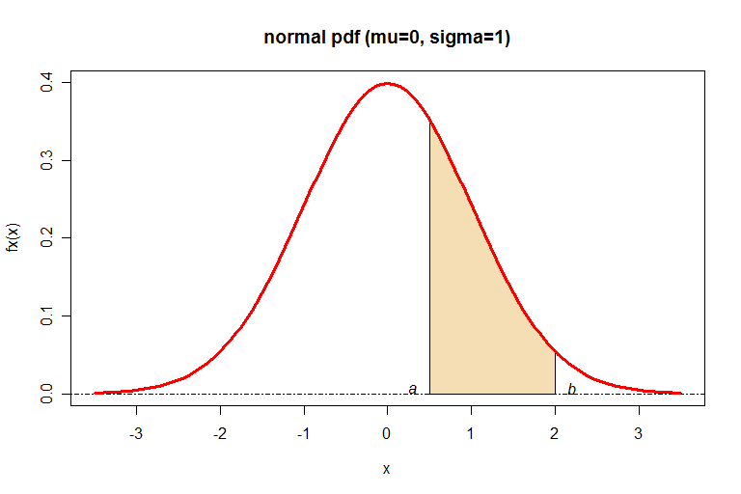
Standard Normal Distribution

Slide 54
Mode
Mode

Slide 55
Median
Median

Slide 56
Expectations
Expected value

Slide 57
Normal Mode

Slide 58
Normal Median

Slide 59
Standard Normal Expectation
Suppose that is, X has an standard normal distribution N(0,1). Then,

Slide 60
Properties of Expectation
Properties of expectation

Slide 61
Moments of random variables
Moment

Slide 62
Mean and Variance
Variance

Slide 63
Properties of Variance
Properties of variances

Slide 64
Standard Normal Variance

Slide 65
Moment Generating Function
Moment generating function

Slide 66
Normal Moment Generation Function

Slide 67
Deriving moments from mgf
Deriving moments

Slide 68
Standard Normal Moments

